Slide 1
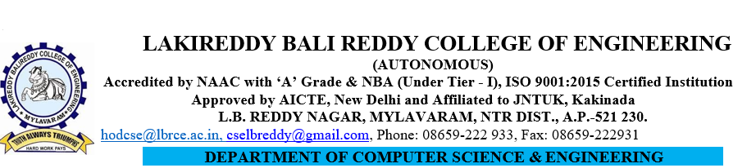
Comparitive Analysis of Detection of Text from Morse Code in Images using CNN
Under Guidance Of Presented By
SK. Johny Basha 19761A0528
Sr. Asst. Prof 19761A0537
20765A0505

Slide 2
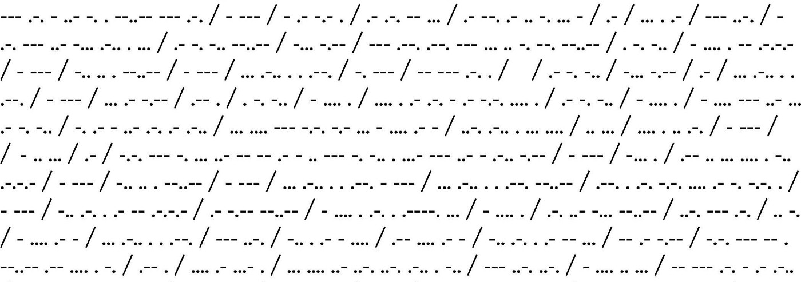
Introduction
Detection of text from images of morse code is a complex process and there is no active research in this area. As these are images, different people can have different styles of writing.
Even though we have these problems, we intend to built a machine learning model which will extract the morse code present in the input image and convert that morse code to the English language with the help of convolutional neural networks with better accuracy.

Slide 3

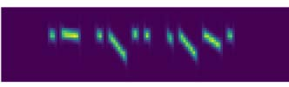
Motivation
Base Paper : https://ieeexplore.ieee.org/document/9051374
In this paper, the deep learning method is introduced to construct a neural network model as the Morse decoding system, which is a novel approach in the relevant field.
Here, the time frequency signals i.e : audio signals are taken as input to the model, CNN’s are used to extract the important features from the input, BLSTM network used to label feature frames from CNN. Then the RNN’s are used for the sequential based character recognition.

Slide 4
Objectives
We are building a dataset, which consists of 100 images of each character present in morse code, as there are 36 characters we intend to create a dataset consisting of 3,600 images.
Performing data segmentation on the input images
Predicting the segmented images individually
Combining the outputs for the final result i.e : English text

Slide 5
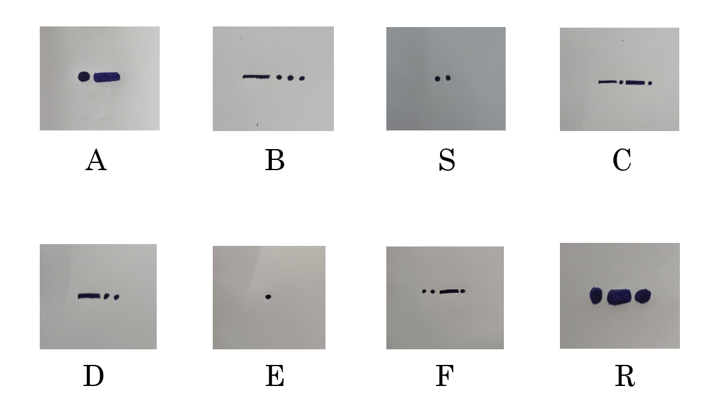
Dataset Creation

Slide 6
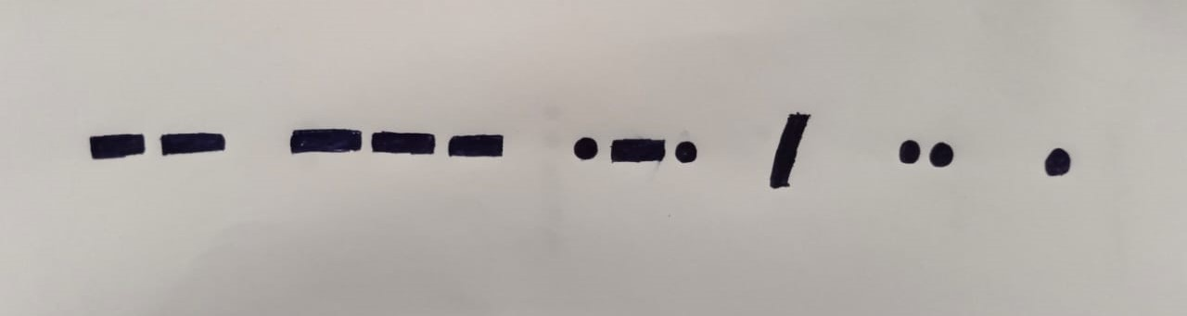
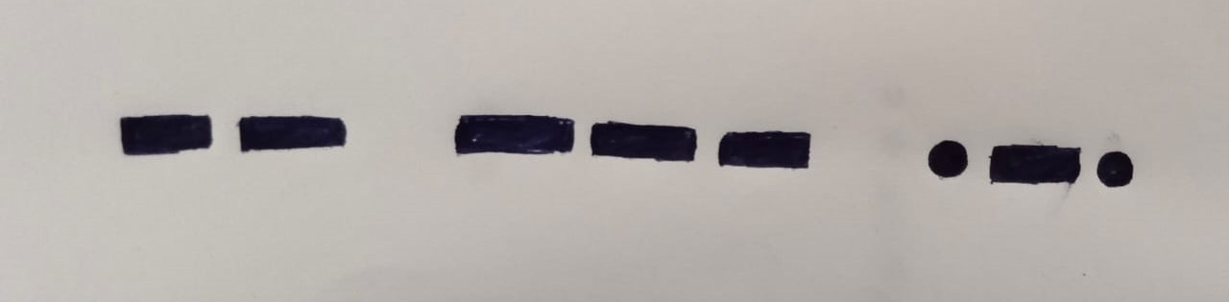
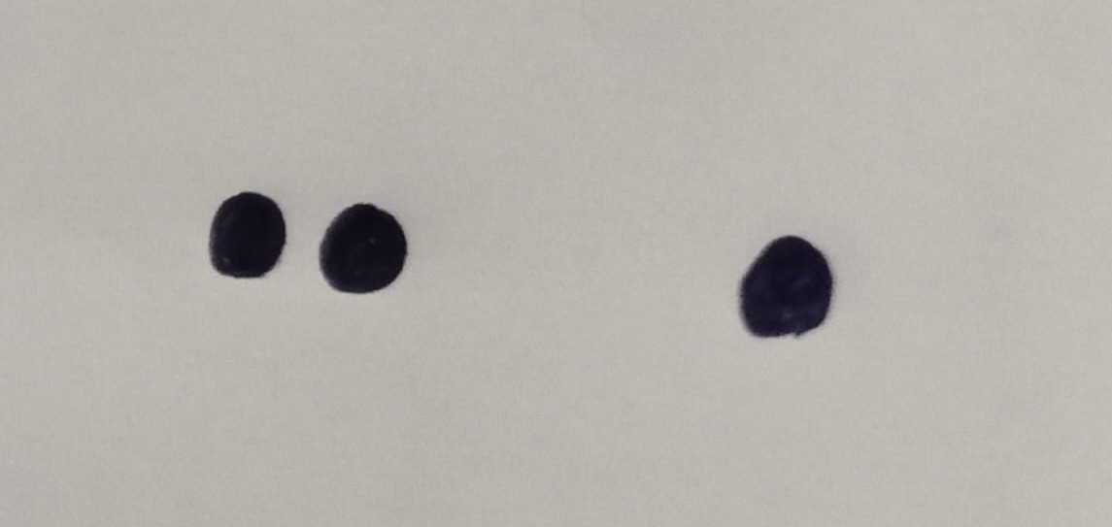
Data Segmentation
After Word Segmentation
Word - 1
Word - 2

Slide 7
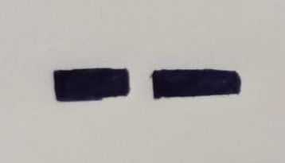
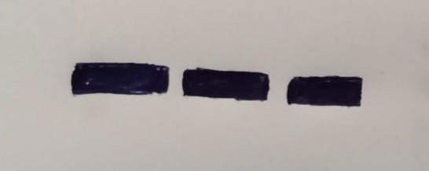
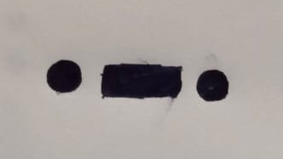
Character Segmentation
After Character Segmentation
Character - 1
Character - 2
Character - 3

Slide 8
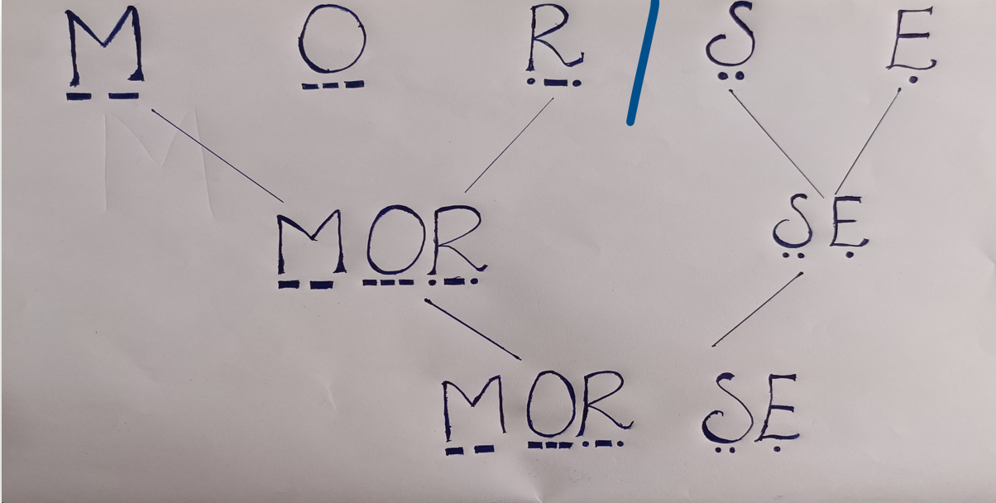
Combining the Results

Slide 9
Literature Survey
Research on Automatic Decoding of Morse Code Based on Deep Learning
Advantages : The model will detect the morse code present in the audio and then convert it into English text with 90% accuracy
Limitations : We can only give frequency signals(audio) as input and moreover many times the high pitch signals cannot be predicted effectively.
Morse Code Datasets for Machine Learning
Advantages : We can create the datasets for the morse code symbols effectively, so that any machine learning algorithms can be applied to get the predictions of the morse code images.
Limitations : In every image the space between the long pulse and short pulse must be same, if it differs then the whole model will be effected.

Slide 10
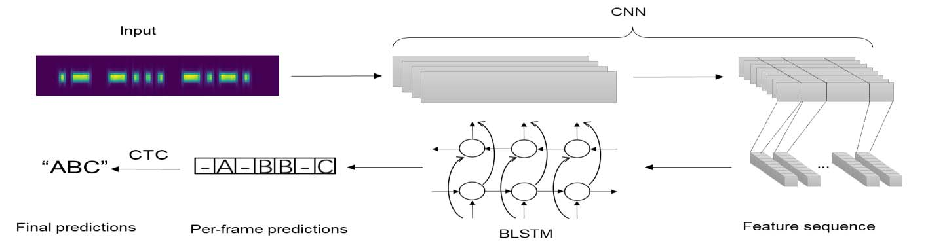
Methodology
Drawbacks
If the input signals have high frequency (>700HZ), the model will not perform well.
If the length of the input signal is more than 4s the model will unable to identify input signal.
The CTC process is very time consuming to annotate a dataset on character level.
The BLSTM require more memory to train and take longer time to train.
In the RNN, if we are using activation functions, then it becomes tedious to process long sequences.

Slide 11
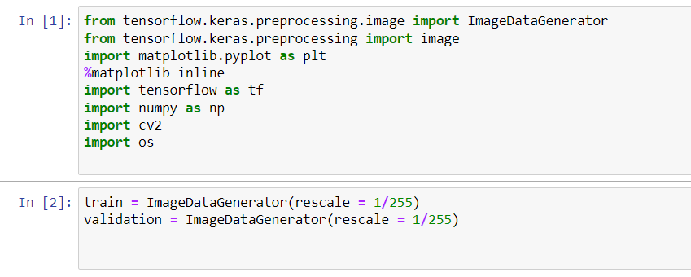
Proposed Technique
At first, we need to know if we built a machine learning model, then whether this model will predict the images of morse code or not.

Slide 12
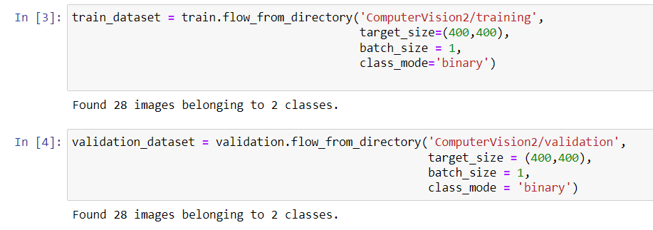
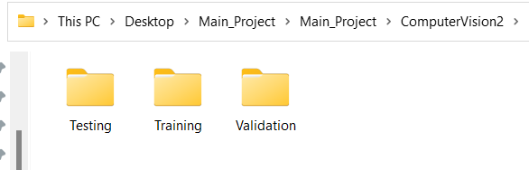
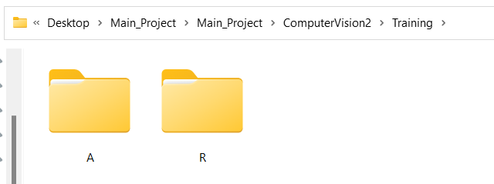

Slide 13
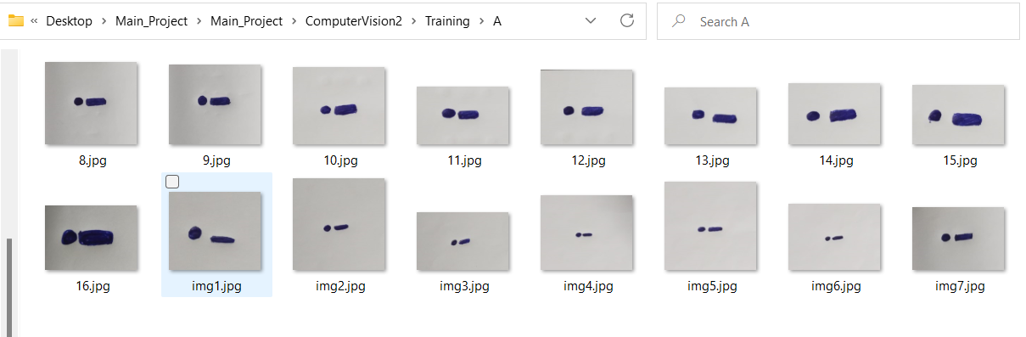
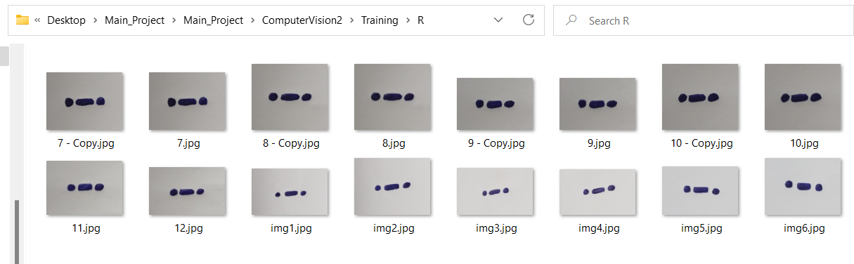

Slide 14
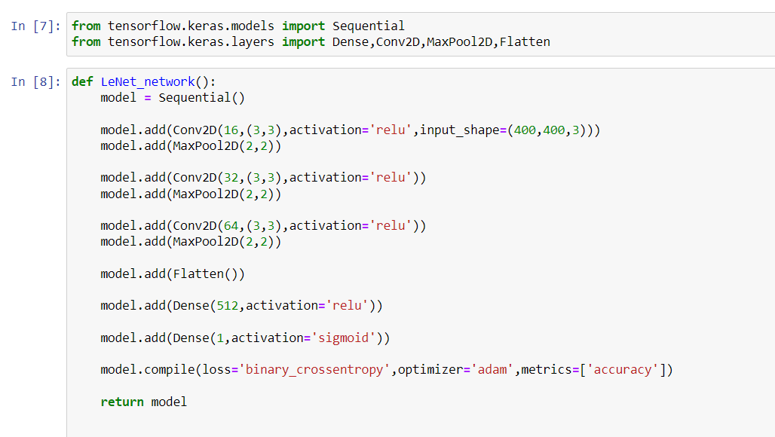
Building LeNet Model
We have taken a Sequential model
Then we have added Conv2D layer, with an activation function relu.
The activation function relu , does not activate all the neurons and it is used to avoid vanishing gradient problem.
The pooling layers are used to reduce the dimensions of the feature map, and the maxpool is used to get the maximum value of the feature map
The flatten layer is used to convert all the 2D arrays from pooled feature maps into a single long continuous linear vector.

Slide 15
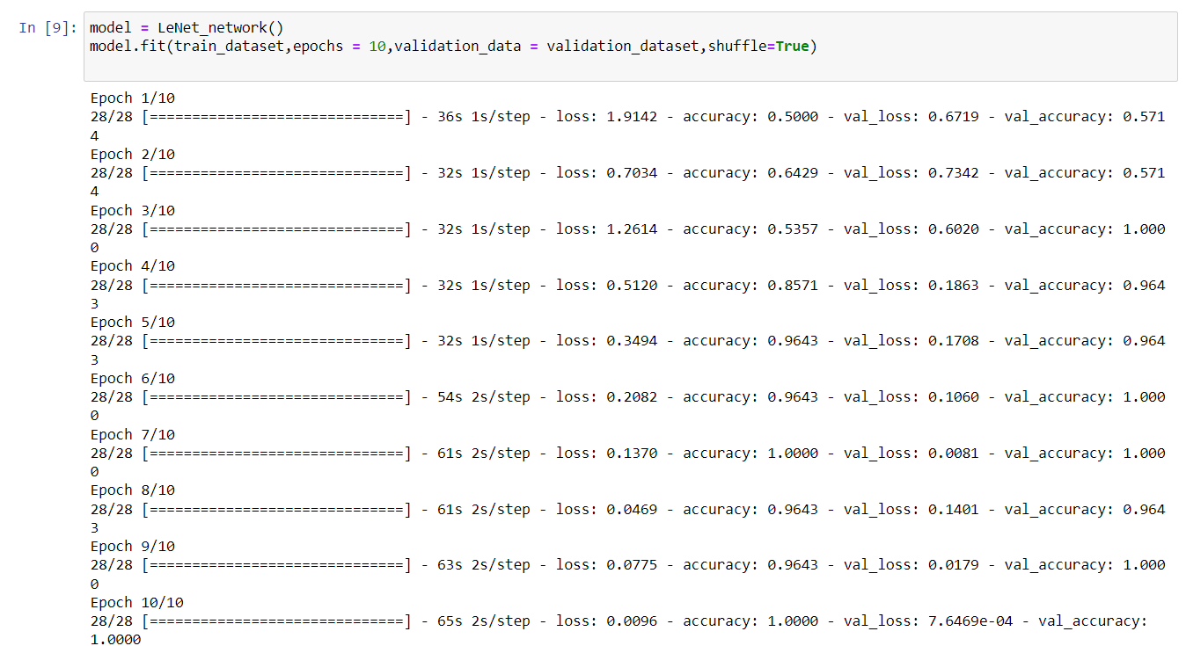
Fitting the Model

Slide 16
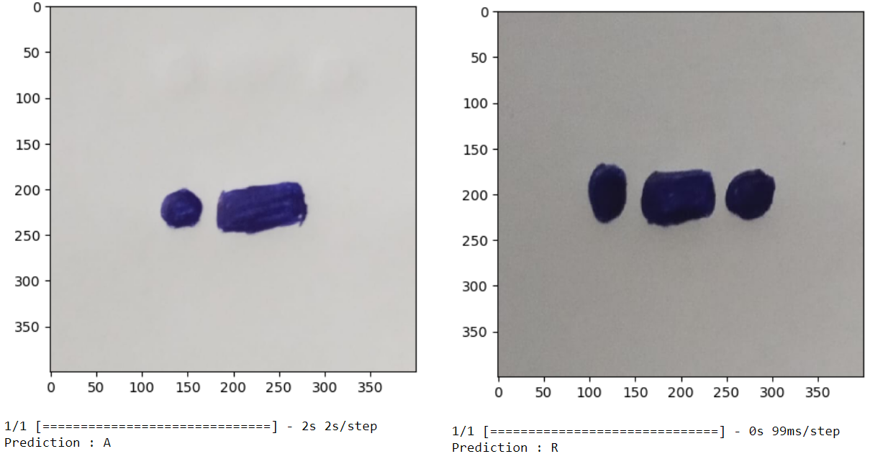
Predictions

Slide 17
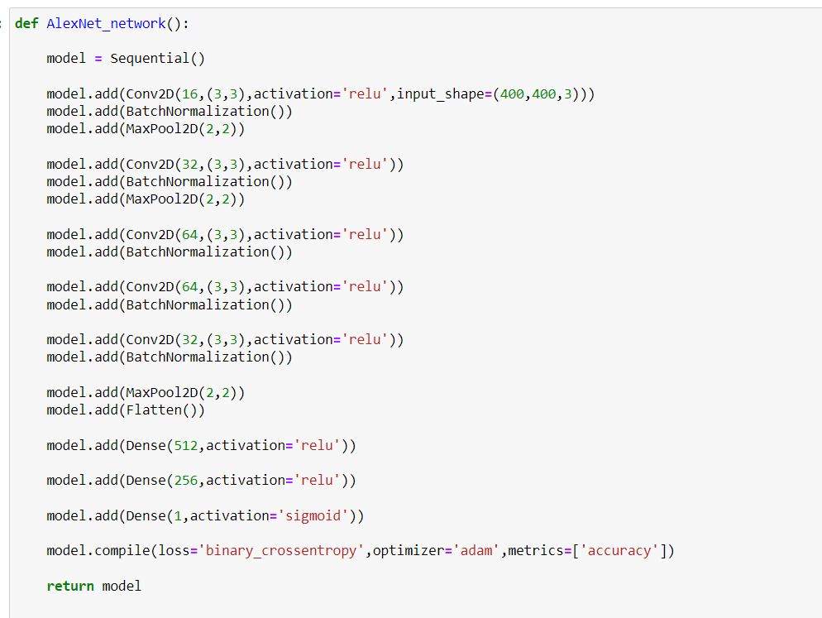
Building AlexNet Model
Here also we have taken a Sequential model.
In the AlexNet, the Batch Normalization layer is added.
This Batch Normalization layers are used to decrease the epochs, increase the speed and performance of neural networks.
In a Neural Network the optimizers are used to reduce the overall loss and increase the accuracy.
Here we have used Adam optimizer, because Adam optimizers have faster computation time and require fewer parameters for tuning.

Slide 18
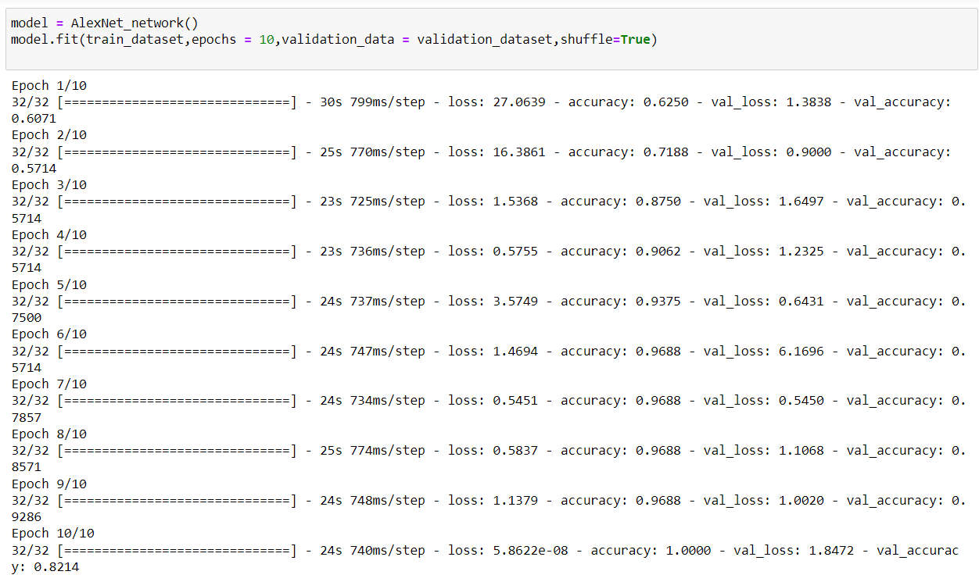
Fitting the Model

Slide 19
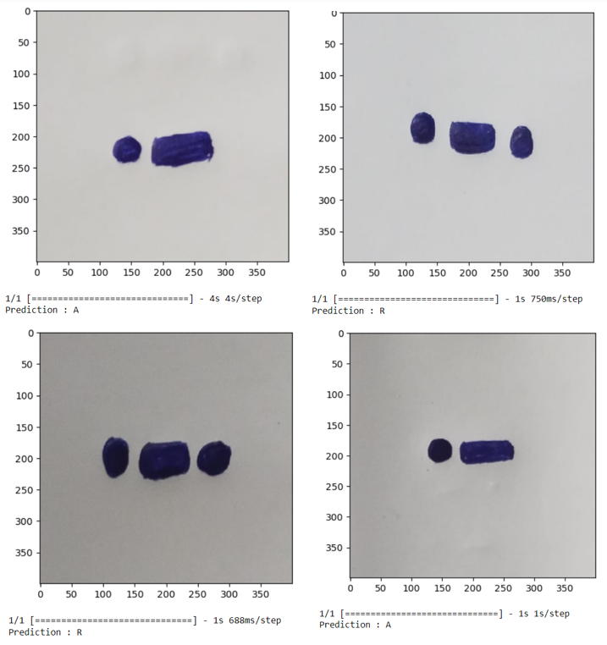
Predictions

Slide 20
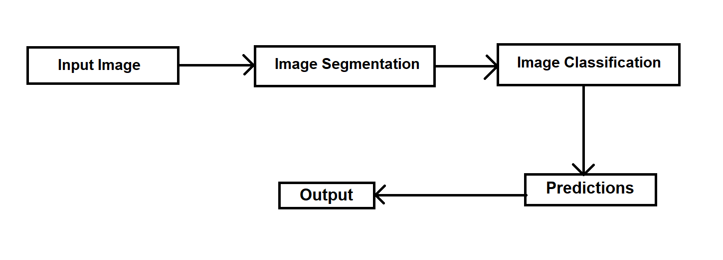
Workflow

Slide 21
Future Work
We will update the Dataset size and increase number of classes to 26.
We will train the model again with the newly updated dataset.
We will update the epochs according to the accuracy and val loss.
As we have implemented the LeNet architecture, in the upcoming days we implement better CNN architectures such as AlexNet, InceptionNet, GoogleNet, VGGNet, ResNet likewise.
After applying all these architectures, then we will gonna decide which CNN architecture is better performing for our problem.

Slide 22
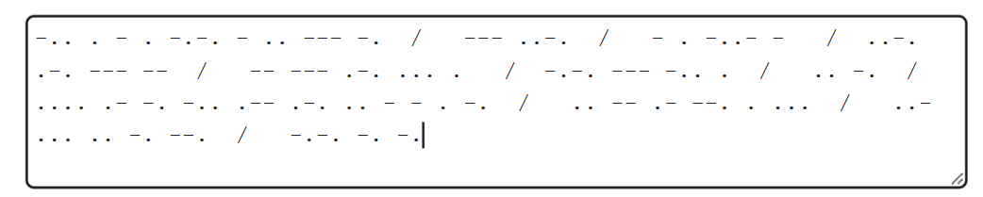
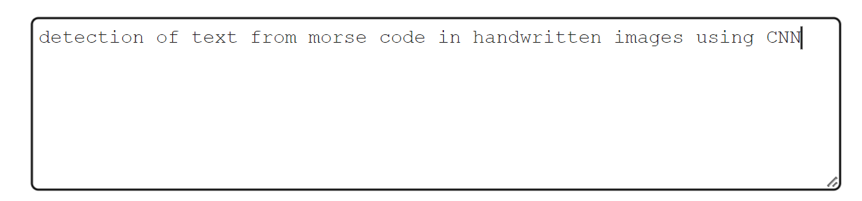
Conclusion
We will built a machine learning model, which take morse code images as input, detect the morse code and then convert the morse code into English text with better accuracy.
INPUT EXPECTED OUTPUT

Slide 23
THANK YOU

